Slide 1
NATURAL LANGUAGE PROCESSING (NLP)
DSN LEKKI-AJAH
BY ABEREJO HABEEBLAH O.
X: @haberejo
Day 1

Slide 2
Why are we here
To equip learners with skills on how Artificial Intelligence Models are built, learn Machine Learning, Deep Learning and focus on Natural Language Processing (NLP).
We should build some project too right?
Yes!!
If you are in with me

Slide 3
Classes Structure
Twice weekly throughout the month of March.
8 classes in total.
Each class for about 1:45 minutes
Days are not so specific, my schedule can be OUCH,
Understand me bikoooo

Slide 4
Who should be here
Anyone willing to learn something new
You aspire to work as a Data Scientist
You aspire to work as a Machine Learning Engr.
You are a researcher with interest in AI
Which of these are you?????

Slide 5
Who should be here
Have some experience handling data
Understand basic python programming language
Have some idea about ML and Deep learning
You ticked all the boxex???
Let’s Gooooooo

Slide 6
Where Do We Begin
- Understanding Machine Learning
- Machine Learning common algorithms (aka Shallow Algorithms)
- Explain Deep Learning
- Deep Learning vs Machine Learning
Don’t worry, I understand you bruh,
I will briefly discuss Ml and
Deep Learning before moving to NLP proper.

Slide 7
Course Structure
- Understanding Machine Learning
- Machine Learning common algorithms (aka Shallow Algorithms)
- Explain Deep Learning
- Deep Learning vs Machine Learning
-
Don’t worry, I understand you bruh,
I will briefly discuss Ml and
Deep Learning before moving to NLP proper.

Slide 8
What is Artificial Intelligence (AI)
Artificial Intelligence is the ability of machines to mimic human intelligence. It enables computers and systems to learn from data, solve problem, and make decisions just like humans do.
AI is when machines start acting like they are smarter than humans.

Slide 9
What is Artificial Intelligence (AI)
Let’s relate like this again:
AI is like teaching your computer to do the thinking for you, only that it doesn’t demand coffee breaks or complain about Mondays!!
hahaha😃😃😃😃
AI is when machines start acting like they are smarter than humans.

Slide 10
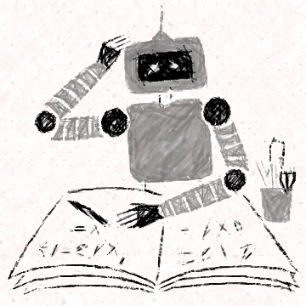
What is Machine Learning (ML)
Machine learning is turning things (data) into numbers and finding patterns in those numbers.
Got It???
Let’s Goooooo!!!

Slide 11
What is Machine Learning (ML)
Think of it as teaching a computer how to recognize patterns without explicitly programming it.
It uses some complex algorithms to find patterns.
Got It???
Let’s Goooooo!!!

Slide 12
What is Machine Learning (ML)
Find pattern? How?
Imagine teaching a child to identify fruits. You show them a banana, an apple, and an orange, telling them the names. After seeing many examples, they can recognize a new banana without needing you to tell them. That’s what ML does—it learns from past examples and generalizes.
Got It???
Let’s Goooooo!!!

Slide 13
What is Deep Learning (DL)
A deeper version of ML. It works like our brain with many layers of learning.
Instead of just learning basic rules, it finds complex patterns automatically by using lots of examples.
Got It???
Let’s Goooooo!!!

Slide 14
What is Deep Learning (DL)
It uses multi-layered neural networks (i.e Deep Neural Networks) to automatically extract features from data.
It is especially effective for tasks like image recognition, speech processing, and NLP.
Got It???
Let’s Goooooo!!!

Slide 15
What is Deep Learning (DL)
Neural networks? How?
Imagine teaching a robot to recognize handwriting. Traditional ML would require manually programming rules for different letters. But Deep Learning would just look at thousands of handwritten examples and figure out the differences itself—like how humans learn handwriting by seeing and practicing.
Got It???
Let’s Goooooo!!!

Slide 16

AI vs ML vs Deep Learning (DL)
AI is like a robotic assistant that can follow instructions,
ML is when it learns from experience,
DL is when it learns so deeply that it can recognize faces, voices, and even create art! 🎨🤖
Artificial Intelligence
Machine Learning
Deep
Learning
Where do we group NLP??

Slide 17
AI vs ML vs Deep Learning (DL)
Artificial Intelligence
Machine Learning
Deep
Learning
NLP is a sub of NLP..

Slide 18
AI vs ML vs Deep Learning (DL)
Let’s relate with this:
AI is like a kitchen assistant following recipes, ML is like a cook who tweaks dishes based on feedback, and DL is like a top chef who invents new recipes just by understanding flavors! 🍳🤖🔥
Artificial Intelligence
Machine Learning
Deep
Learning
Got It???
Let’s Goooooo!!!

Slide 19
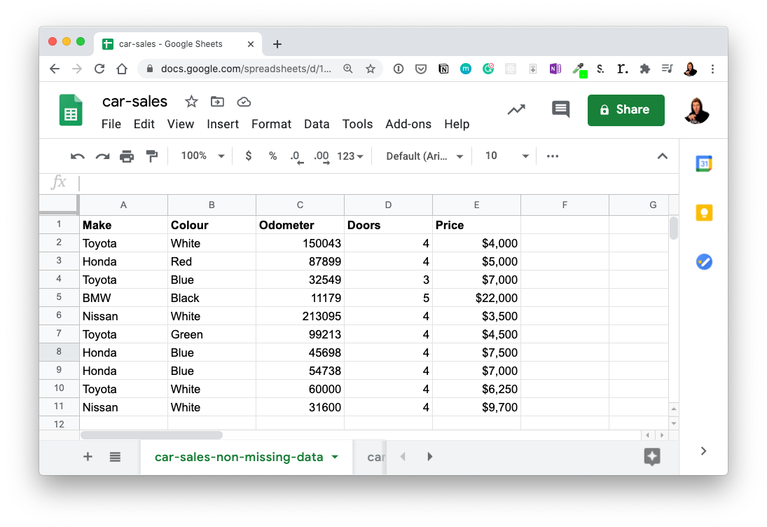


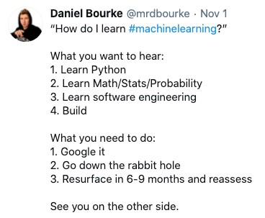



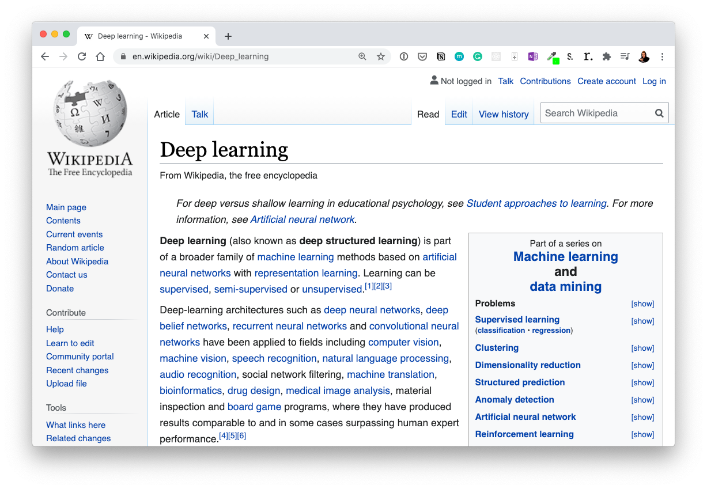

ML vs DL
..
Machine Learning
Deep Leanring
Structured data
Unstructured Data

Slide 20
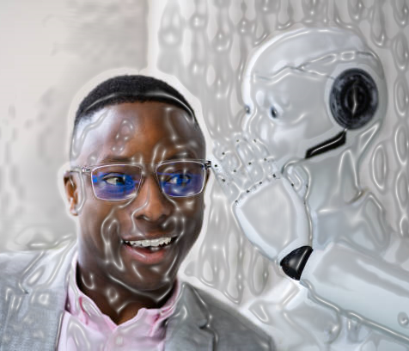
What is Natural Language Processing (NLP)
NLP helps computers understand and talk like humans.
It enables computers to read, interpret, and generate human-like text.
It allows your phone to predict your next word, understand voice commands, and translate languages.
NLP combines ML and Deep Learning to process and understand human language.
Includes tasks like stemming, tokenization, NER, sentiment analysis.
NER – named entity recognition
Here is a scenario; Imagine chatting with a smart assistant (like ChatGPT or Siri). You say, “What’s the weather today?”, and it understands your words, fetches present weather data, and responds. That’s NLP in action.

Slide 21
Natural Language Processing (NLP) in Industry
Voice Assistants 🎙️: Siri, Alexa, and Google Assistant understand and respond to your voice commands.
Chatbots 💬: Websites use NLP-powered bots to answer your questions instantly.
Autocorrect & Predictive Text 📱: Your phone suggests next words while typing to speed things up, Also can correct spellings when you typed wrongly.
Search Engines 🔍: To understands what you mean, even if you type a messy query.
Translation Apps 🌍: Google Translate helps you understand different languages.
Spam Filters 📧: Your email sorting out spam messages automatically.
Sentiment Analysis 😃😡: Companies analyze tweets and reviews to see what people feel about their brand.
All this industry examples uses NLP in operation. Can I get from you??

Slide 22
Brief History of Natural Language Processing (NLP)
2011: George Dahl and Microsoft Research trained a deep neural network to recognize words from speech recordings—a major deep learning breakthrough in NLP.
2012: AlexNet revolutionized deep learning in image recognition, leading to increased interest in machine vision.
2015: Deep learning models started competing in NLP tasks like machine translation, matching traditional ML accuracy with less effort and lower computational cost.
2016-2017: Deep learning models in NLP became more efficient and began outperforming traditional ML approaches in accuracy.
Impact: Enabled real-time translation on mobile devices without requiring an internet connection, making NLP more accessible and practical.
All this industry examples uses NLP in operation.

Slide 23
What’s Next 😃😃
Maybe I don’t know also
After all of the theoretical explanation, can we begin some hands-on or we stop here today?

Slide 24
What’s Next 😃😃
Maybe I don’t know also
If Yes, 😃😃
Let’s get our Machine setup for hands-on.

Slide 25
Setting up our PC
We need install some tools if we are to work locally (i.e without internet)
Since we are online, we may not delve into this page in details
If you will be working locally, ensure to install the following
Python (ensure to add to path when installing)
Jupyter Lab (I like to use command - pip install jupyterlab – in my CMD/Terminal)
Tensorflow (use the command - pip install tensorflow – into your CMD/Terminal)
Some frameworks and libraries we will use as we move
If working online,
Visit google colab and let’s start

Slide 26
What’s Next 😃😃
Maybe I don’t know also
After setup,😃😃
Let’s begin proper proper

Slide 27
The END
DSN LEKKI-AJAH
BY ABEREJO HABEEBLAH O.
X: @haberejo
Day 1

Slide 28
NATURAL LANGUAGE PROCESSING (NLP)
DSN LEKKI-AJAH
BY ABEREJO HABEEBLAH O.
X: @haberejo
Day 2

Slide 29
How computer sees language
Computers see text as a sequence of character,
Computers don’t understand words or meaning like humans do
They see all English words as binary language (i.e. 1s and 0s)
So, now, we need to help computer understand our language to what it can fully understand
What do we do to help computers understand the text? Let’s GO
Binary Language == 1 and 0

Slide 30
Understand Human Language
There are arguably 3 steps to help computer understand human texts,
Text Preprocessing
Tokenization
Numerical Representation (Word Embedding)
Now, Lets discuss each further!!
Binary Language == 1 and 0

Slide 31
Step 1: Text Preprocessing
Why Preprocess Text?
Imagine you have a room full of clothes, toys, and papers scattered everywhere. Finding what you need is hard, right?
Raw text data is similar. It's full of "noise" – things that make it difficult for computers to understand the meaning.
Got It???
Let’s Goooooo!!!

Slide 32
Step 1: Text Preprocessing
At this stage, lets understand preprocessing of text,
Proper Text preprocessing is important to make sure we are only feeding the right processed information into our algorithm and irrelevant text are gone.
Got It???
Let’s Goooooo!!!
e.g: The Quick! bRoWn foX juMPS.

Slide 33
Step 1: Text Preprocessing
Text preprocessing cleans and prepares text data for NLP tasks. It addresses issues like inconsistencies (uppercase/lowercase), irrelevant information (stop words), and variations in word forms (running vs. run). This makes it easier for NLP models to learn.
Got It???
Let’s Goooooo!!!
e.g: The Quick! bRoWn foX juMPS.

Slide 34
Step 1: Text Preprocessing
We prepare text by:
Lowercasing
Removing Punctuation Marks
Removing Stopwords (i.e words like A, of, in, etc)
Stemming / Lemmatization
NB:
There is no specific way to prepare text, it is much dependent on what type of NLP project we are building!
e.g: The Quick! bRoWn foX juMPS.

Slide 35
Step 1: Text Preprocessing
1. Lowercasing: To humans, A capitalized word at the beginning of a sentence (e.g., She) has the same meaning as when it’s used later in a sentence (she).
By converting all characters in a corpus to lowercase, we disregard any use of capitalization.
Computers treat "The" and "the" as different words. Lowercasing makes everything consistent.
The Quick! bRoWn foX juMPS.
the quick! brown fox jumps.
NB:
Corpus in this regard means collection of writings.

Slide 36
Step 1: Text Preprocessing
Though, in a larger corpus that has many more examples of individual uses of words, the word, general (an adjective meaning “widespread”) have different meaning to the word General (a noun meaning the commander of an army). One option is not to lowercase everything, or try an option called Part-Of-Speech (POS) Tagging
The Quick! bRoWn foX juMPS.
the quick! brown fox jumps.
NB:
Corpus in this regard means collection of writings.

Slide 37
Step 1: Text Preprocessing
2. Removing Punctuation Marks: Punctuation marks generally don’t add much value to a natural language model and so are often removed.
Removing punctuation would not be an advantage in all cases. Consider, for example, if you were building a question-answering algorithm, which could use question marks to help it identify questions.
The Quick! bRoWn foX juMPS.
the quick brown fox jumps
Depending on the NLP project, some steps are compulsory

Slide 38
Step 1: Text Preprocessing
3. Removing Stopwords: Stopwords are frequently occurring words that tend to contain relatively little distinctive meaning, such as the, at, which, and, of etc.
There is no universal consensus on the precise list of stop words, but depending on your application it may be sensible to ensure that certain words are (or aren’t!) considered to be stop words.
The Quick! bRoWn foX juMPS.
quick brown fox jumps
Depending on the NLP project, some steps are compulsory

Slide 39
Step 1: Text Preprocessing
For example, when building a model to classify movie reviews as positive or negative. Some lists of stop words include negations like didn’t, isn’t, and wouldn’t that might be critical for our model to identify the sentiment of a movie review, so these words probably shouldn’t be removed.
Negations may be helpful as stop words for some classifiers but probably not for a sentiment classifier
So be careful with this one. In many instances, it will be best to remove only a limited number of stop words.
The Quick! bRoWn foX juMPS.
quick brown fox jumps
Depending on the NLP project, some steps are compulsory

Slide 40
Step 1: Text Preprocessing
4. Stemming / Lemmatization:
Stemming: Stemming is the truncation of words down to their stem, i.e their root form.
For example, the words house, housed and housing both have the stem hous.
With smaller datasets in particular, stemming can be productive because it pools words with similar meanings into a single token.
There will be more examples of this stemmed token’s context, enabling techniques like word2vec or GloVe to more accurately identify an appropriate location for the token in word-vector space
To stem words, you can use the Porter algorithm5 provided by nltk. To do this, you create an instance of a PorterStemmer() object and then add its stem() method
The Quick! bRoWn foX juMPS.
quick brown fox jumps
Depending on the NLP project, some steps are compulsory

Slide 41
Step 1: Text Preprocessing
this stemmed token’s context, enabling techniques like word2vec or GloVe to more accurately identify an appropriate location for the token in word-vector space
To stem words, you can use the Porter algorithm5 provided by nltk. To do this, you create an instance of a PorterStemmer() object and then add its stem() method
The Quick! bRoWn foX juMPS.
quick brown fox jumps
Depending on the NLP project, some steps are compulsory

Slide 42
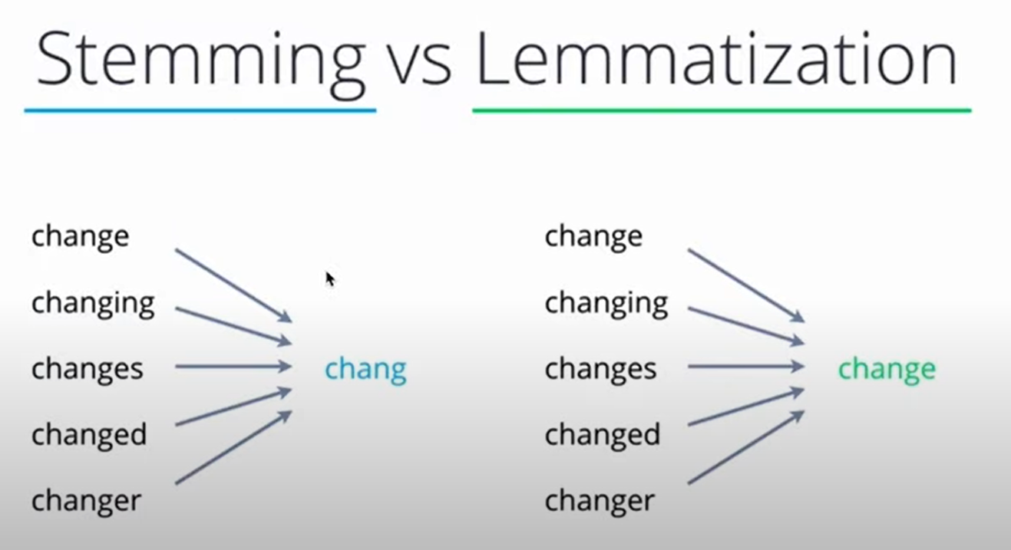
Step 1: Text Preprocessing
From this comparison, Stemming returns to its root form. Stemming is quite harsh
While
Lemmatization is quite flexible and return it to a common word.
Choose based on the kind of words you have and your project.

Slide 43
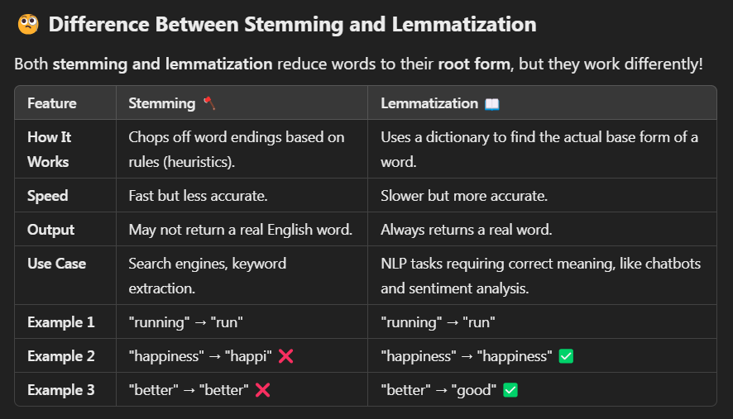
Step 1: Text Preprocessing
Stemming follows simple rules to cut off suffixes like -ing, -ed, or -ly.
Lemmatization uses linguistic knowledge to find the true root form of a word.

Slide 44
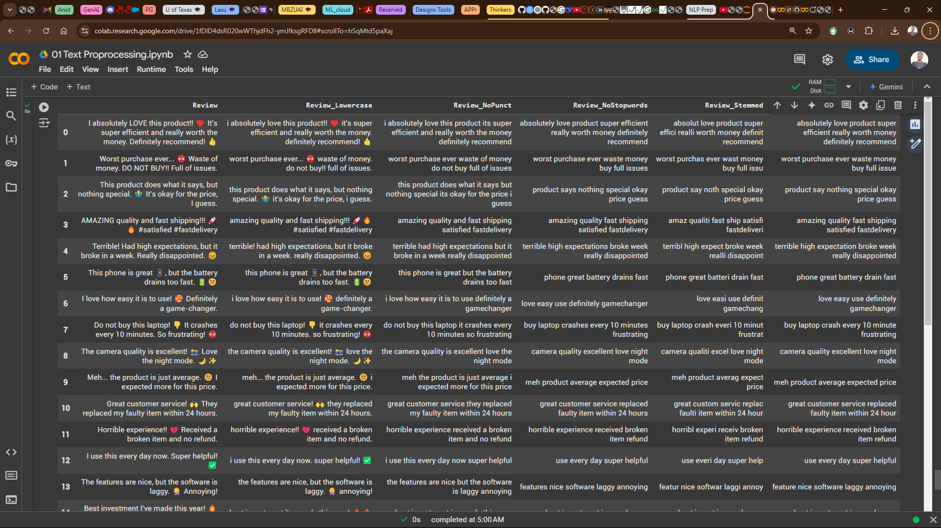
Step 1: Text Preprocessing
Love it Right????, I love it too

Slide 45
Some Discussion
Text -> Turn into numbers -> build a model -> train the model to find patterns -> use patterns (make predictions)
That’s the flow
🧠 🧠 🧠 🧠 🧠 🧠 🧠 🧠 🧠 🧠 🧠 🧠 🧠 🧠 🧠 🧠 🧠 🧠 🧠 🧠 🧠 🧠 🧠 🧠 🧠 🧠 🧠 🧠 🧠 🧠 🧠 🧠 🧠 🧠 🧠 🧠 🧠 🧠 🧠 🧠 🧠 🧠 🧠 🧠 🧠 🧠 🧠 🧠

Slide 46
📌 Everything in a tip
You've successfully completed text preprocessing on customer feedback data. We've covered:
✔️ Lowercasing – Ensuring consistency in text.
✔️ Removing Punctuation & Emojis – Cleaning unnecessary characters.
✔️ Stopword Removal – Keeping only meaningful words.
✔️ Stemming & Lemmatization – Reducing words to their root form for better NLP.
🔥🔥 🔥🔥🔥 🔥🔥🔥 🔥🔥🔥 🔥🔥🔥 🔥🔥🔥 🔥

Slide 47
Let’s move on
Text -> turn into numbers -> build a model -> train the model to find patterns -> use patterns (make predictions)
If you understand everything up to this point, identify yourself as a Machine Learning Engineer specializing in Natural Language Processing! 😃😃😃😃
🧠 🧠 🧠 🧠 🧠 🧠 🧠 🧠 🧠 🧠 🧠 🧠 🧠 🧠 🧠 🧠 🧠 🧠 🧠 🧠 🧠 🧠 🧠 🧠 🧠 🧠 🧠 🧠 🧠 🧠 🧠 🧠 🧠 🧠 🧠 🧠 🧠 🧠 🧠 🧠 🧠 🧠 🧠 🧠 🧠 🧠 🧠 🧠

Slide 48
🧠 Time for quick Brain Teaser🔍
We've cleaned, transformed, and optimized text like real NLP pros! Now, let's see how well you followed along.🧐
Question: Given this raw text:👉
"I'm LOVING this NLP session!!! 😍🔥 It's AMAZING how we can clean text properly. But... is it always the best approach?“
If we apply the following preprocessing steps, what will be the output at each stage?
1️⃣ Lowercasing: What does the text look like after converting to lowercase?

Slide 49
🧠 Time for quick Brain Teaser🔍
1️⃣ Lowercasing: What does the text look like after converting to lowercase?
"I'm LOVING this NLP session!!! 😍🔥 It's AMAZING how we can clean text properly. But... is it always the best approach?“
✅ "i'm loving this nlp session!!! 😍🔥 it's amazing how we can clean text properly. but... is it always the best approach?"

Slide 50
🧠 Time for quick Brain Teaser🔍
Question: Given this raw text:👉
"I'm LOVING this NLP session!!! 😍🔥 It's AMAZING how we can clean text properly. But... is it always the best approach?“
If we apply the following preprocessing steps, what will be the output at each stage?
2️⃣ Removing Punctuation & Emojis: What’s left after getting rid of #,!, 😍🔥, and other punctuation marks?

Slide 51
🧠 Time for quick Brain Teaser🔍
2️⃣ Removing Punctuation & Emojis: What’s left after getting rid of #,!, 😍🔥, and other punctuation marks?
"I'm LOVING this NLP session!!! 😍🔥 It's AMAZING how we can clean text properly. But... is it always the best approach?“
✅ "im loving this nlp session its amazing how we can clean text properly but is it always the best approach"

Slide 52
🧠 Time for quick Brain Teaser🔍
Question: Given this raw text:👉
"I'm LOVING this NLP session!!! 😍🔥 It's AMAZING how we can clean text properly. But... is it always the best approach?“
If we apply the following preprocessing steps, what will be the output at each stage?
3️⃣ Stopword Removal: Which words will be removed, and what remains?

Slide 53
🧠 Time for quick Brain Teaser🔍
3️⃣ Stopword Removal: Which words will be removed, and what remains?
"I'm LOVING this NLP session!!! 😍🔥 It's AMAZING how we can clean text properly. But... is it always the best approach?“
✅ "loving nlp session amazing clean text properly always best approach"

Slide 54
🧠 Time for quick Brain Teaser🔍
Question: Given this raw text:👉
"I'm LOVING this NLP session!!! 😍🔥 It's AMAZING how we can clean text properly. But... is it always the best approach?“
If we apply the following preprocessing steps, what will be the output at each stage?
4️⃣ Stemming & Lemmatization: If we use:
Porter Stemmer, how would words like "loving" and "amazing" change?
Lemmatization, what would be the base form of "loving" and "clean"?

Slide 55
🧠 Time for quick Brain Teaser🔍
4️⃣ Stemming & Lemmatization: If we use:
Porter Stemmer, how would words like "loving" and "amazing" change?
"I'm LOVING this NLP session!!! 😍🔥 It's AMAZING how we can clean text properly. But... is it always the best approach?“
loving" → "love“
"amazing" → "amaz“
"clean" → "clean" (remains the same)
✅ "love nlp session amaz clean text proper always best approach"

Slide 56
🧠 Time for quick Brain Teaser🔍
4️⃣ Stemming & Lemmatization: If we use: Lemmatization (Using WordNet Lemmatizer), what would be the base form of "loving" and "clean"?
"I'm LOVING this NLP session!!! 😍🔥 It's AMAZING how we can clean text properly. But... is it always the best approach?“
"loving" → "love“
"amazing" → "amazing" (unchanged)
"clean" → "clean“
✅ "love nlp session amazing clean text properly always best approach"

Slide 57
🧠 🚀 Bonus Question: 🔍
We removed stopwords to clean up our text. But can you think of a situation where removing stopwords might actually hurt the meaning or usefulness of our data?🤔
What can be done in such case???
💡 Hint: Think about cases where small words like "not," "is," or "to" are important in understanding the sentence.
Open-ended answers are welcomed!!!

Slide 58
🧠 🚀 Bonus Question: 🔍
Answer: ✅ Yes! There are several cases where stopwords play a crucial role:
1️⃣ Sentiment Analysis – Words like "not" and "very" can change sentiment.
Example: "The movie is not bad" (removing "not" changes the meaning).
2️⃣ Question Answering – Stopwords help retain context in queries.
Example: "What is the capital of France?" makes more sense than just "capital France?“
3️⃣ Machine Translation – Removing stopwords might lead to incorrect translations.
Example: Translating "I am going to the market" without "am" and "to" could alter the meaning.
So, while removing stopwords often helps clean data, it's important to consider the task before blindly dropping them! 🚀

Slide 59
🧠 Try This
💡 Try This! Modify the dataset with your own text and observe how preprocessing affects different types of input.
Generate into a CSV File and share before the end of the program.
Let’s keep building! 🔥🔥🔥

Slide 60
Let’s move on
Text -> turn into numbers -> build a model -> train the model to find patterns -> use patterns (make predictions)
If you understand everything up to this point, identify yourself as a Machine Learning Engineer specializing in Natural Language Processing! 😃😃😃😃
🧠 🧠 🧠 🧠 🧠 🧠 🧠 🧠 🧠 🧠 🧠 🧠 🧠 🧠 🧠 🧠 🧠 🧠 🧠 🧠 🧠 🧠 🧠 🧠 🧠 🧠 🧠 🧠 🧠 🧠 🧠 🧠 🧠 🧠 🧠 🧠 🧠 🧠 🧠 🧠 🧠 🧠 🧠 🧠 🧠 🧠 🧠 🧠

Slide 61
Step 2: Tokenization
What is Tokenization?
Tokenization is the process of splitting a text into individual units, called tokens.
These tokens can be words, subwords, characters, or even punctuation marks. It’s an important step in most NLP pipelines, as it prepares the text for further processing.

Slide 62
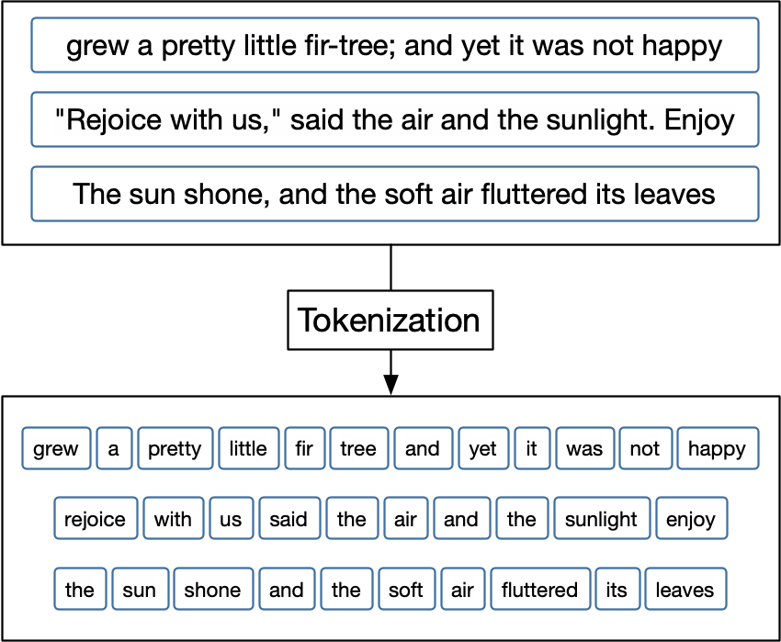
Step 2: Tokenization
What is a Token?
Tokens make it easier for computers to analyze text.
E.G: grew is a token.
Pretty is a token

Slide 63
Step 2: Tokenization
There are different types of tokenization:
Sentence Tokenization (Sentence-Level Tokenization)
Word Tokenization (Word-Level Tokenization)
Subword Tokenization
Character-level Tokenization

Slide 64
Step 2: Tokenization
There are different types of tokenization:
Sentence Tokenization (Sentence-Level Tokenization): Splits text into individual sentences. Important for tasks like text summarization or machine translation.
Example:
"The cat sat on the mat. The dog barked."
becomes
["The cat sat on the mat.", "The dog barked."]
Uses the .sent_tokenize() method of the nltk.tokenize library

Slide 65
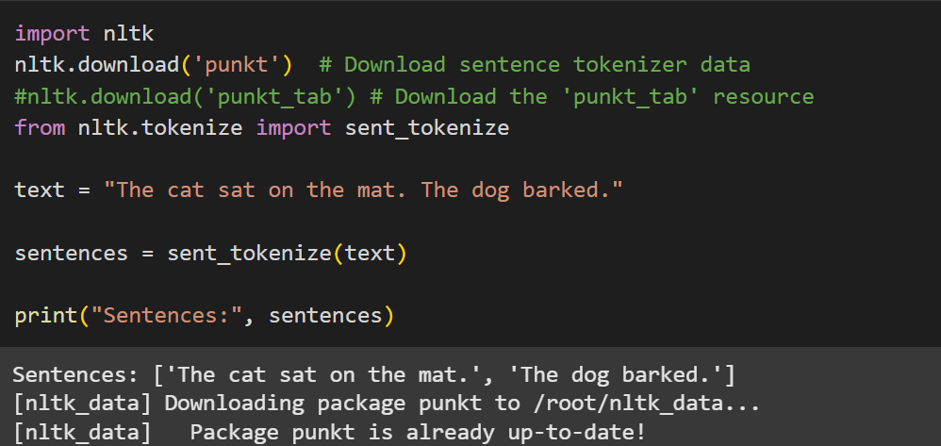
Step 2: Tokenization
Code sample:

Slide 66
Step 2: Tokenization
Word Tokenization (Word-Level Tokenization): Splits text into individual words. This is the most common type.
Example:
"The cat sat on the mat. The dog barked."
becomes
['The', 'cat', 'sat', 'on', 'the', 'mat', '.', 'The', 'dog', 'barked', '.’]
Uses the .word_tokenize() method of the nltk.tokenize library

Slide 67
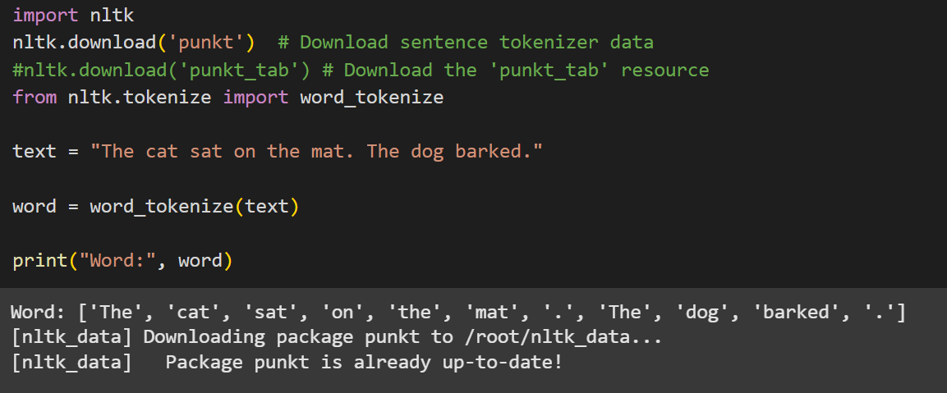
Step 2: Tokenization
Code sample:

Slide 68
Step 2: Tokenization
Word tokenization and other examples are great, but what happens when our computer encounters a word it hasn't seen before?
Imagine you're learning English and you come across the word 'unbreakable.' You might not know it, but you know 'break' and 'able’.
Think of learning a new language. You might not know every single word, but you can often figure out the meaning of a new word if you recognize parts of it.
Subword tokenization is a way to handle these 'out-of-vocabulary' (OOV) words. It breaks words into smaller parts, called subwords, so the computer can understand them even if it hasn't seen the whole word before.

Slide 69
Step 2: Tokenization
Subword Tokenization: Splits words into smaller units (subwords). This is crucial for handling out-of-vocabulary words and morphologically rich languages. Common methods include Byte Pair Encoding (BPE) and WordPiece.
Example:
"unbreakable"
might be tokenized as
["un", "break", "able"].
This allows the model to understand the meaning even if it hasn't seen "unbreakable" before, as it recognizes "break," "un," and "able."

Slide 70
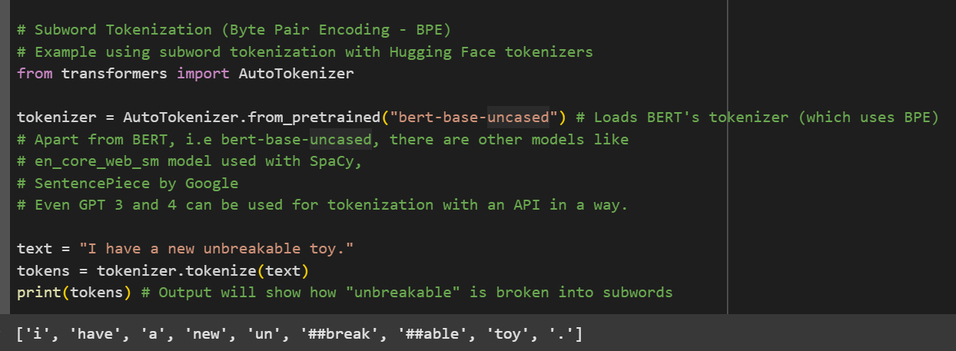
Step 2: Tokenization
Code sample:

Slide 71
Step 2: Tokenization
Character-level Tokenization: Splits text into individual characters. Useful for languages with complex morphology or when dealing with misspellings.
Example:
"cat"
becomes
["c", "a", "t"]
Character-level Tokenization are useful in Spelling Corrections, New text Generation as learned from patterns of character sequences and also when handling noisy data.

Slide 72
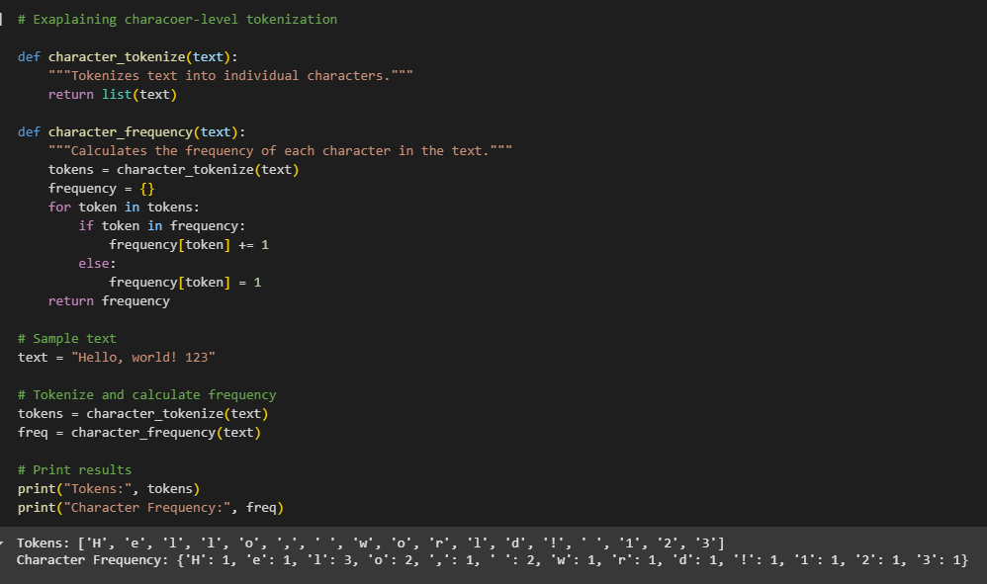
Step 2: Tokenization
Code sample:

Slide 73
Step 2: Tokenization
While character-level tokenization offers advantages, it also has drawbacks:
Longer Sequences: Character sequences are much longer than word sequences, which can make training models more computationally expensive.
Loss of Word-Level Meaning: It doesn't capture the semantic meaning of words as effectively as word-level or subword tokenization.

Slide 74
Step 3: Numerical Representation
The next step, which is almost always done immediately after tokenization, is to convert those tokens into numerical representations.
So, this step converts the tokens into numbers.
There are several ways to do this:
Word Embeddings (aka Word Vectors) which uses techniques like Word2Vec, GloVe, FastText, BERT.
One-Hot Encoding
Vocabulary and Integer Encoding

Slide 75
Step 3: Numerical Representation
Why is Numerical Representation necessary:
Machine learning models (and deep learning models) operate on numbers. They cannot directly process text.
The numerical representation is the bridge between human-readable text and machine-understandable data.
Almost every NLP task, from sentiment analysis to machine translation, requires a numerical representation of text. Without it, we can't apply any machine learning algorithms.

Slide 76
Step 3: Numerical Representation
How does Numerical Representation Works in NLP Projects:
Preprocessing: You'd typically tokenize your text and immediately convert the tokens to numbers (using one of the mentioned in a slide before) before feeding the data to your model.
Model Input: The numerical representation (integer encoded, one-hot encoded, or embeddings) becomes the input to your NLP model.
Model Training: The model learns patterns in these numbers, which correspond to patterns in the original text.

Slide 77
Step 3: Numerical Representation
Vocabulary and Integer Encoding
This method of Numerical Representation convert token to numbers in three steps
Build a Vocabulary: Create a list of all unique tokens in your training data. This list is your vocabulary.
"The cat sat on the mat. The dog barked."
becomes
["the", "cat", "sat", "on", "mat", ".", "dog", "barked"]
NB: Notice that the word the appeared just once in the generated list called Vocabulary

Slide 78
Step 3: Numerical Representation
b) Integer Encoding: Assign a unique integer to each token in the vocabulary.
i.e: The == 0, cat == 1, sat == 2, on == 3, mat == 4, . == 5, dog == 6, barked == 7
c) Convert Tokens to Integers: Replace each token in your tokenized text with its corresponding integer ID from the vocabulary.
i.e [0, 1, 2, 3, 0, 4, 5, 0, 6, 7]

Slide 79
Step 3: Numerical Representation
Example: Let's say the sentence is "The cat sat on the mat. The dog barked.“.
Stage 1: Vocabulary is: ["the", "cat", "sat", "on", "mat", ".", "dog", "barked"]
Stage 2: The == 0, cat == 1, sat == 2, on == 3, mat == 4, . == 5, dog == 6, barked == 7
Stage 3: encoded token to integer becomes: [0, 1, 2, 3, 0, 4, 5, 0, 6, 7]
NB: The "The" and "the" are normally considered different tokens (unless you do lowercasing first, which was expected to have been done in this regard).
Each word is assigned a unique integer ID. Again, simple, but doesn't capture semantic relationships. Often used as a preliminary step, especially for word embeddings.

Slide 80
Step 3: Numerical Representation
The Vocabulary and Integer Encoding method is simple to implement and understand, but doesn't capture semantic relationships, therefore not so used in the industry like the other two methods.

Slide 81
Step 3: Numerical Representation
One-Hot Encoding: This is a traditional approach to encoding natural language numerically for processing it with a machine.
In this approach, the words of natural language in a sentence (e.g., “the,” “bat,” “sat,” “on,” “the,” and “cat”) are represented by the columns of a matrix. Each row in the matrix, meanwhile, represents a unique word.
If there are 100 unique words across the corpus of documents you’re feeding into your natural language algorithm, then your matrix of one-hot-encoded words will have 100 rows.
If there are 1,000 unique words across your corpus, then there will be 1,000 rows in your one-hot matrix, and so on.

Slide 82
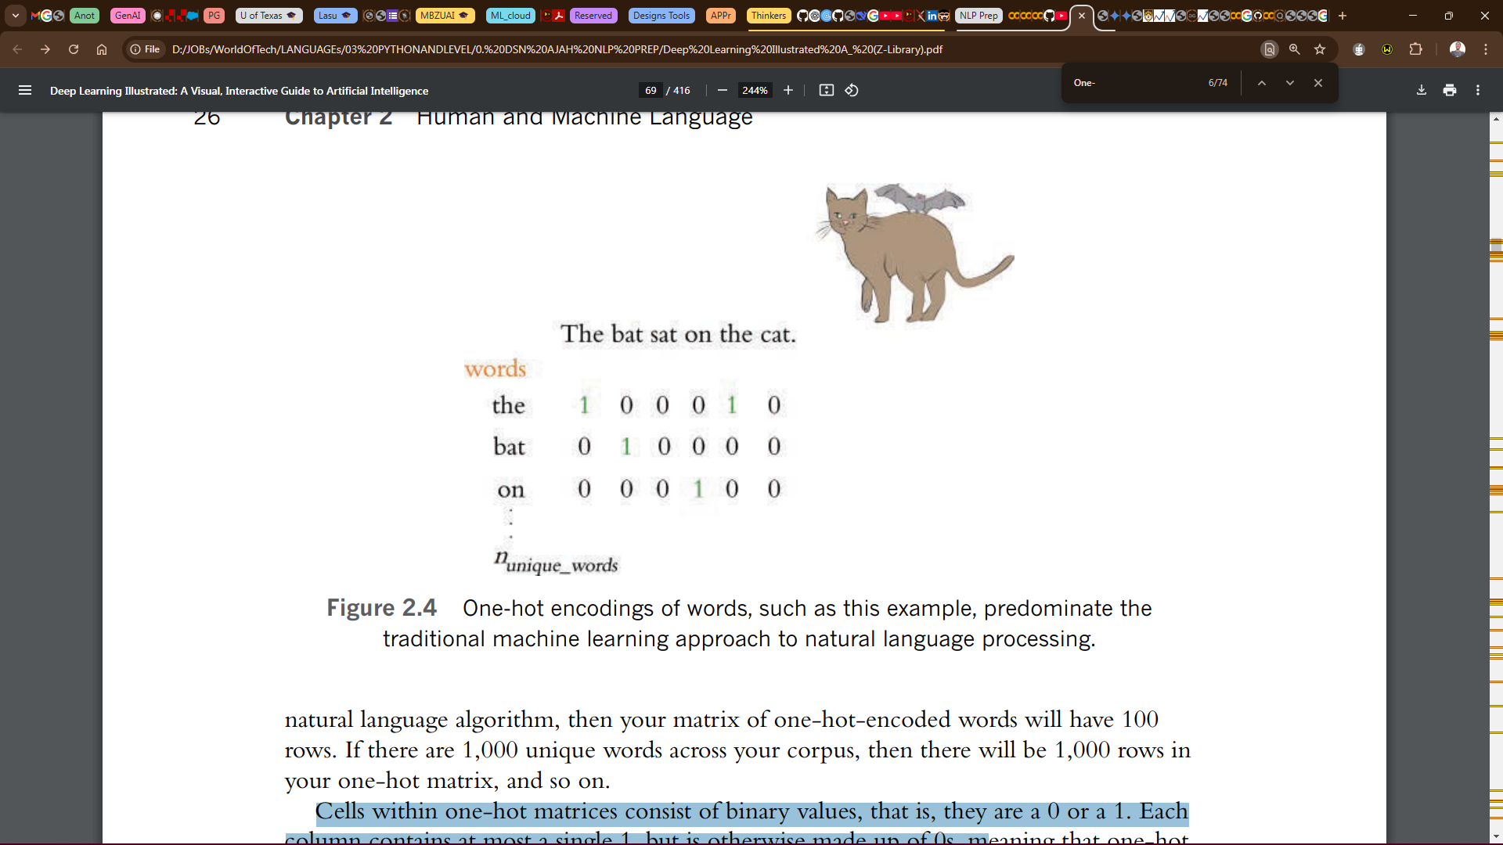
Step 3: Numerical Representation
Cells within one-hot matrices consist of binary values, that is, they are a 0 or a 1.
Each column contains at most a single 1, but is otherwise made up of 0s.
In this example, the entire corpus has only six words, five of which are unique.

Slide 83
Step 3: Numerical Representation
One-hot word representations like this are fairly straightforward, and they are an acceptable format for feeding into a deep learning model (or, indeed, other machine learning models).
However, the simplicity and sparsity of one-hot representations are limiting when incorporated into a natural language application.
It’s can be used for simpler NLP tasks or as a basic representation. It’s also simple but doesn't capture semantic relationships and therefore not the best option for major NLP projects.

Slide 84
Step 3: Numerical Representation
Word Embeddings (aka Word Vectors): This approach is a specific and powerful type of numerical representation designed to capture semantic meaning.
Vector representations of words are the information-dense alternative to one-hot encodings of words. Whereas one-hot representations capture information about word location only, word vectors (also known as word embeddings or vector-space embeddings) capture information about word meaning as well as location.
The key advantage, word vectors enable deep learning NLP models to automatically learn linguistic features.
Its uses techniques like Word2Vec, GloVe, FastText, BERT.

Slide 85
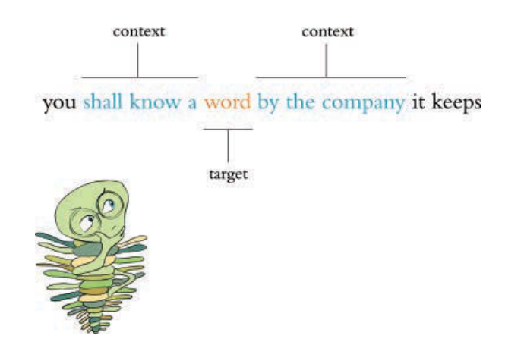
Step 3: Numerical Representation
Word Embedding (aka Word Vectors) uses techniques like Word2Vec, GloVe, FastText, BERT. Word2Vec, GloVe, are most popular.

Slide 87
Step 2: Tokenization
There are different types of tokenization:
Sentence Tokenization (Sentence-Level Tokenization): Splits text into individual sentences. Important for tasks like text summarization or machine translation.Example: "The cat sat on the mat. The dog barked." becomes ["The cat sat on the mat.", "The dog barked."]Splitting text into sentences. Using the .sent_tokenize() method
Word Tokenization (Word-Level Tokenization): Splits text into individual words. This is the most common type.
Example: "The cat sat on the mat." becomes ["The", "cat", "sat", "on", "the", "mat", "."]. Using the .word_tokenize() method
Subword Tokenization: This involves using a transformer-based tokenizer like (BPE - Byte Pair Encoding), WordPiece).
Word-level Tokenization:

Slide 88
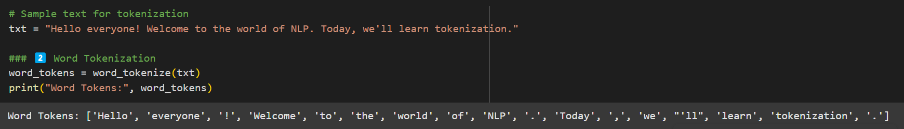
Step 2: Tokenization
What is Tokenization?Tokenization is the process of splitting a text into individual units, called tokens. These tokens can be words, subwords, characters, or even punctuation marks. It's the first step in most NLP pipelines, as it prepares the text for further processing.Tokenization: Tokenization is the process of breaking text into individual units (tokens).
There are different types of tokenization:
- Sentence Tokenization (aka Sentence-Level Tokenization): Splitting text into sentences. Using the .sent_tokenize()method
- Word Tokenization (aka Word-Level Tokenization): is splitting text into words. Using the .word_tokenize()method
- Subword Tokenization: This involves using a transformer-based tokenizer like (BPE [Byte Pair Encoding], WordPiece).
The Quick! bRoWn foX juMPS.
the quick! brown fox jumps.
NB:
Corpus in this regard means collection of writings.

Slide 89
A Glossary of Essential AI/ML/DL/NLP Terminologies
This is a PLUS +
General AI Terms are:
Artificial Intelligence (AI): The broad concept of creating machines that can perform tasks that usually require human intelligence. Simple: Making computers smart like us. Scenario: Imagine a robot that can cook dinner, do laundry, and even hold a conversation.
Agent: An entity (software or hardware) that perceives its environment and acts to achieve a goal. Simple: Something that can see what's around it and make decisions to do something. Scenario: Think of a video game character. It sees the game world (environment) and you control it to jump, shoot, etc. (actions) to win the game (goal).

Slide 90
A Glossary of Essential AI/ML/DL/NLP Terminologies
This is a PLUS +
Machine Learning (ML): A subset of AI where machines learn from data without being explicitly programmed. Simple: Teaching a computer to learn by showing it examples, like training a dog with treats. Scenario: A music app recommending songs you might like. It learns your taste based on what you've listened to before.
Deep Learning (DL): A subfield of ML using artificial neural networks with many layers to learn complex patterns. Simple: A really complex way of teaching a computer, like how our brains learn with lots of interconnected parts. Scenario: Image recognition software that can tell the difference between a cat and a dog, even if they look similar.
Natural Language Processing (NLP): A branch of AI focused on enabling computers to understand, interpret, and generate human language. Simple: Teaching computers to understand and talk like us. Scenario: Google Translate, which can translate text from one language to another.

Slide 91
A Glossary of Essential AI/ML/DL/NLP Terminologies
This is a PLUS +
Machine Learning Terms:
Supervised Learning: Learning from labeled data (input-output pairs). Simple: Teaching a computer with answer keys. Scenario: Training a program to predict house prices. You give it examples of houses with their sizes, locations, and prices (the "answer key").
Unsupervised Learning: Learning from unlabeled data, finding patterns. Simple: Giving a computer a bunch of stuff and asking it to sort it into groups. Scenario: A website suggesting groups you might like to join based on your interests.
Reinforcement Learning: An agent learns by interacting with an environment and getting rewards or penalties. Simple: Training a pet with positive and negative reinforcement. Scenario: An AI playing a video game. It gets points for winning and loses points for losing, learning to play better over time.
Training Data: The data used to train a model. Simple: The examples you show the computer to learn from. Scenario: All the photos of cats and dogs you use to train the image recognition software.
Test Data: Data used to check how well the trained model performs on new data. Simple: Showing the computer pictures it hasn't seen before to see if it learned correctly. Scenario: Using a different set of cat and dog photos to test the image recognition software.
Feature: A measurable characteristic. Simple: A detail about something. Scenario: In predicting house prices, features are size, location, number of rooms, etc.
Model: A mathematical representation of learned patterns. Simple: The rules the computer learns. Scenario: The formula the computer uses to predict house prices.
Algorithm: The specific set of rules or instructions used for learning. Simple: The method the computer uses to learn. Scenario: Different ways of training a computer, like different study techniques.
Overfitting: A model that learns the training data too well (including noise) and performs poorly on test data. Simple: Memorizing the answers to practice questions but failing the real test. Scenario: A model that can perfectly predict prices of houses it has seen, but it can't predict prices of houses it has not seen.
Underfitting: A model that is too simple to capture the patterns and performs poorly on both training and test data. Simple: Not studying enough and failing the test. Scenario: A model that is too simple to predict house prices.Accuracy: How often the model makes correct predictions. Simple: How often the computer gets the answer right.Precision: Out of all positive predictions, how many were actually positive? Simple: Of all the things the computer said were cats, how many were actually cats?Recall: Out of all actually positive cases, how many did the model correctly identify? Simple: Of all the actual cats, how many did the computer correctly identify?Bias: Systematic error in the model due to flawed assumptions. Simple: A prejudice in the computer's thinking. Scenario: A model trained only on pictures of sunny days will be biased and might not recognize cloudy days.Variance: Sensitivity of the model to fluctuations in the training data. Simple: The computer getting confused by small changes in the examples. Scenario: A model that works perfectly on one set of data but fails on another very similar set of data.Hyperparameters: Parameters set before training that control the learning process. Simple: Settings you adjust before you start training. Scenario: Like adjusting the focus and brightness on a camera before taking a picture.Deep Learning Terms:Neural Network: Interconnected layers of neurons that process information. Simple: A network of connected "brains" working together.Neuron (Node): A basic processing unit in a neural network. Simple: A single "brain" in the network.Layer: A group of neurons (input, hidden, output layers). Simple: A level in the network.Activation Function: Introduces non-linearity to neurons. Simple: A way for the "brains" to make more complex decisions.Backpropagation: Adjusting connection weights to minimize prediction errors. Simple: A way for the network to learn from its mistakes.Epoch: One complete pass through the entire training dataset. Simple: Showing the computer all the examples once.Batch Size: Number of training examples processed at once. Simple: How many examples the computer looks at at a time.Optimization Algorithm: Used to adjust model parameters. Simple: The method the computer uses to learn.Loss Function: Measures the model's prediction error. Simple: How the computer knows it made a mistake.Weight: The strength of the connection between two neurons. Simple: How strongly two "brains" influence each other.Learning Rate: How quickly the model updates its weights. Simple: How quickly the computer learns.Natural Language Processing Terms:Tokenization: Breaking down text into tokens (words, phrases). Simple: Splitting a sentence into words.Stop Words: Common words (e.g., "the," "a," "is") often removed. Simple: Words that don't carry much meaning.Stemming: Reducing words to their root form. Simple: Chopping off the endings of words.Lemmatization: Reducing words to their dictionary form (lemma). Simple: Finding the base word.Word Embeddings: Representing words as vectors capturing semantic relationships. Simple: Giving each word a set of coordinates in "meaning-space."Sentiment Analysis: Determining the emotional tone of text. Simple: Figuring out if someone is happy or sad based on what they wrote.Machine Translation: Translating text from one language to another.Text Summarization: Generating a concise summary of text.Named Entity Recognition (NER): Identifying and classifying named entities. Simple: Finding and labeling names of people, places, and organizations.Corpus: A large collection of text. Simple: A big library of text.
Binary Language == 1 and 0

Slide 92
A Glossary of Essential AI/ML/DL/NLP Terminologies
This is a PLUS +
Machine Learning Terms:
Supervised Learning: Learning from labeled data (input-output pairs). Simple: Teaching a computer with answer keys. Scenario: Training a program to predict house prices. You give it examples of houses with their sizes, locations, and prices (the "answer key").
Unsupervised Learning: Learning from unlabeled data, finding patterns. Simple: Giving a computer a bunch of stuff and asking it to sort it into groups. Scenario: A website suggesting groups you might like to join based on your interests.
Reinforcement Learning: An agent learns by interacting with an environment and getting rewards or penalties. Simple: Training a pet with positive and negative reinforcement. Scenario: An AI playing a video game. It gets points for winning and loses points for losing, learning to play better over time.

Slide 93
A Glossary of Essential AI/ML/DL/NLP Terminologies
This is a PLUS +
Machine Learning Terms:
Supervised Learning: Learning from labeled data (input-output pairs). Simple: Teaching a computer with answer keys. Scenario: Training a program to predict house prices. You give it examples of houses with their sizes, locations, and prices (the "answer key").
Unsupervised Learning: Learning from unlabeled data, finding patterns. Simple: Giving a computer a bunch of stuff and asking it to sort it into groups. Scenario: A website suggesting groups you might like to join based on your interests.
Reinforcement Learning: An agent learns by interacting with an environment and getting rewards or penalties. Simple: Training a pet with positive and negative reinforcement. Scenario: An AI playing a video game. It gets points for winning and loses points for losing, learning to play better over time.
Training Data: The data used to train a model. Simple: The examples you show the computer to learn from. Scenario: All the photos of cats and dogs you use to train the image recognition software.
Test Data: Data used to check how well the trained model performs on new data. Simple: Showing the computer pictures it hasn't seen before to see if it learned correctly. Scenario: Using a different set of cat and dog photos to test the image recognition software.
Feature: A measurable characteristic. Simple: A detail about something. Scenario: In predicting house prices, features are size, location, number of rooms, etc.
Model: A mathematical representation of learned patterns. Simple: The rules the computer learns. Scenario: The formula the computer uses to predict house prices.
Algorithm: The specific set of rules or instructions used for learning. Simple: The method the computer uses to learn. Scenario: Different ways of training a computer, like different study techniques.
Overfitting: A model that learns the training data too well (including noise) and performs poorly on test data. Simple: Memorizing the answers to practice questions but failing the real test. Scenario: A model that can perfectly predict prices of houses it has seen, but it can't predict prices of houses it has not seen.
Underfitting: A model that is too simple to capture the patterns and performs poorly on both training and test data. Simple: Not studying enough and failing the test. Scenario: A model that is too simple to predict house prices.Accuracy: How often the model makes correct predictions. Simple: How often the computer gets the answer right.Precision: Out of all positive predictions, how many were actually positive? Simple: Of all the things the computer said were cats, how many were actually cats?Recall: Out of all actually positive cases, how many did the model correctly identify? Simple: Of all the actual cats, how many did the computer correctly identify?Bias: Systematic error in the model due to flawed assumptions. Simple: A prejudice in the computer's thinking. Scenario: A model trained only on pictures of sunny days will be biased and might not recognize cloudy days.Variance: Sensitivity of the model to fluctuations in the training data. Simple: The computer getting confused by small changes in the examples. Scenario: A model that works perfectly on one set of data but fails on another very similar set of data.Hyperparameters: Parameters set before training that control the learning process. Simple: Settings you adjust before you start training. Scenario: Like adjusting the focus and brightness on a camera before taking a picture.Deep Learning Terms:Neural Network: Interconnected layers of neurons that process information. Simple: A network of connected "brains" working together.Neuron (Node): A basic processing unit in a neural network. Simple: A single "brain" in the network.Layer: A group of neurons (input, hidden, output layers). Simple: A level in the network.Activation Function: Introduces non-linearity to neurons. Simple: A way for the "brains" to make more complex decisions.Backpropagation: Adjusting connection weights to minimize prediction errors. Simple: A way for the network to learn from its mistakes.Epoch: One complete pass through the entire training dataset. Simple: Showing the computer all the examples once.Batch Size: Number of training examples processed at once. Simple: How many examples the computer looks at at a time.Optimization Algorithm: Used to adjust model parameters. Simple: The method the computer uses to learn.Loss Function: Measures the model's prediction error. Simple: How the computer knows it made a mistake.Weight: The strength of the connection between two neurons. Simple: How strongly two "brains" influence each other.Learning Rate: How quickly the model updates its weights. Simple: How quickly the computer learns.Natural Language Processing Terms:Tokenization: Breaking down text into tokens (words, phrases). Simple: Splitting a sentence into words.Stop Words: Common words (e.g., "the," "a," "is") often removed. Simple: Words that don't carry much meaning.Stemming: Reducing words to their root form. Simple: Chopping off the endings of words.Lemmatization: Reducing words to their dictionary form (lemma). Simple: Finding the base word.Word Embeddings: Representing words as vectors capturing semantic relationships. Simple: Giving each word a set of coordinates in "meaning-space."Sentiment Analysis: Determining the emotional tone of text. Simple: Figuring out if someone is happy or sad based on what they wrote.Machine Translation: Translating text from one language to another.Text Summarization: Generating a concise summary of text.Named Entity Recognition (NER): Identifying and classifying named entities. Simple: Finding and labeling names of people, places, and organizations.Corpus: A large collection of text. Simple: A big library of text.
Binary Language == 1 and 0

Slide 94
A Glossary of Essential AI/ML/DL/NLP Terminoligies
General AI Terms are:
Artificial Intelligence (AI): The broad concept of creating machines that can perform tasks that usually require human intelligence. Simple: Making computers smart like us. Scenario: Imagine a robot that can cook dinner, do laundry, and even hold a conversation. That's AI!
Agent: An entity (software or hardware) that perceives its environment and acts to achieve a goal. Simple: Something that can see what's around it and make decisions to do something. Scenario: Think of a video game character. It sees the game world (environment) and you control it to jump, shoot, etc. (actions) to win the game (goal).
Machine Learning (ML): A subset of AI where machines learn from data without being explicitly programmed. Simple: Teaching a computer to learn by showing it examples, like training a dog with treats. Scenario: A music app recommending songs you might like. It learns your taste based on what you've listened to before.
Deep Learning (DL): A subfield of ML using artificial neural networks with many layers to learn complex patterns. Simple: A really complex way of teaching a computer, like how our brains learn with lots of interconnected parts. Scenario: Image recognition software that can tell the difference between a cat and a dog, even if they look similar.
Natural Language Processing (NLP): A branch of AI focused on enabling computers to understand, interpret, and generate human language. Simple: Teaching computers to understand and talk like us. Scenario: Google Translate, which can translate text from one language to another.
Machine Learning Terms:
Supervised Learning: Learning from labeled data (input-output pairs). Simple: Teaching a computer with answer keys. Scenario: Training a program to predict house prices. You give it examples of houses with their sizes, locations, and prices (the "answer key").Unsupervised Learning: Learning from unlabeled data, finding patterns. Simple: Giving a computer a bunch of stuff and asking it to sort it into groups. Scenario: A website suggesting groups you might like to join based on your interests.
Reinforcement Learning: An agent learns by interacting with an environment and getting rewards or penalties. Simple: Training a pet with positive and negative reinforcement. Scenario: An AI playing a video game. It gets points for winning and loses points for losing, learning to play better over time.Training Data: The data used to train a model. Simple: The examples you show the computer to learn from. Scenario: All the photos of cats and dogs you use to train the image recognition software.Test Data: Data used to check how well the trained model performs on new data. Simple: Showing the computer pictures it hasn't seen before to see if it learned correctly. Scenario: Using a different set of cat and dog photos to test the image recognition software.Feature: A measurable characteristic. Simple: A detail about something. Scenario: In predicting house prices, features are size, location, number of rooms, etc.Model: A mathematical representation of learned patterns. Simple: The rules the computer learns. Scenario: The formula the computer uses to predict house prices.Algorithm: The specific set of rules or instructions used for learning. Simple: The method the computer uses to learn. Scenario: Different ways of training a computer, like different study techniques.Overfitting: A model that learns the training data too well (including noise) and performs poorly on test data. Simple: Memorizing the answers to practice questions but failing the real test. Scenario: A model that can perfectly predict prices of houses it has seen, but it can't predict prices of houses it has not seen.Underfitting: A model that is too simple to capture the patterns and performs poorly on both training and test data. Simple: Not studying enough and failing the test. Scenario: A model that is too simple to predict house prices.Accuracy: How often the model makes correct predictions. Simple: How often the computer gets the answer right.Precision: Out of all positive predictions, how many were actually positive? Simple: Of all the things the computer said were cats, how many were actually cats?Recall: Out of all actually positive cases, how many did the model correctly identify? Simple: Of all the actual cats, how many did the computer correctly identify?Bias: Systematic error in the model due to flawed assumptions. Simple: A prejudice in the computer's thinking. Scenario: A model trained only on pictures of sunny days will be biased and might not recognize cloudy days.Variance: Sensitivity of the model to fluctuations in the training data. Simple: The computer getting confused by small changes in the examples. Scenario: A model that works perfectly on one set of data but fails on another very similar set of data.Hyperparameters: Parameters set before training that control the learning process. Simple: Settings you adjust before you start training. Scenario: Like adjusting the focus and brightness on a camera before taking a picture.Deep Learning Terms:Neural Network: Interconnected layers of neurons that process information. Simple: A network of connected "brains" working together.Neuron (Node): A basic processing unit in a neural network. Simple: A single "brain" in the network.Layer: A group of neurons (input, hidden, output layers). Simple: A level in the network.Activation Function: Introduces non-linearity to neurons. Simple: A way for the "brains" to make more complex decisions.Backpropagation: Adjusting connection weights to minimize prediction errors. Simple: A way for the network to learn from its mistakes.Epoch: One complete pass through the entire training dataset. Simple: Showing the computer all the examples once.Batch Size: Number of training examples processed at once. Simple: How many examples the computer looks at at a time.Optimization Algorithm: Used to adjust model parameters. Simple: The method the computer uses to learn.Loss Function: Measures the model's prediction error. Simple: How the computer knows it made a mistake.Weight: The strength of the connection between two neurons. Simple: How strongly two "brains" influence each other.Learning Rate: How quickly the model updates its weights. Simple: How quickly the computer learns.Natural Language Processing Terms:Tokenization: Breaking down text into tokens (words, phrases). Simple: Splitting a sentence into words.Stop Words: Common words (e.g., "the," "a," "is") often removed. Simple: Words that don't carry much meaning.Stemming: Reducing words to their root form. Simple: Chopping off the endings of words.Lemmatization: Reducing words to their dictionary form (lemma). Simple: Finding the base word.Word Embeddings: Representing words as vectors capturing semantic relationships. Simple: Giving each word a set of coordinates in "meaning-space."Sentiment Analysis: Determining the emotional tone of text. Simple: Figuring out if someone is happy or sad based on what they wrote.Machine Translation: Translating text from one language to another.Text Summarization: Generating a concise summary of text.Named Entity Recognition (NER): Identifying and classifying named entities. Simple: Finding and labeling names of people, places, and organizations.Corpus: A large collection of text. Simple: A big library of text.
Binary Language == 1 and 0

